Slide 1
POWER BI AND EXCEL DASHBOARD PORTFOLIO

Slide 2
WORKING WITH MICROSOFT POWER BI

Slide 3
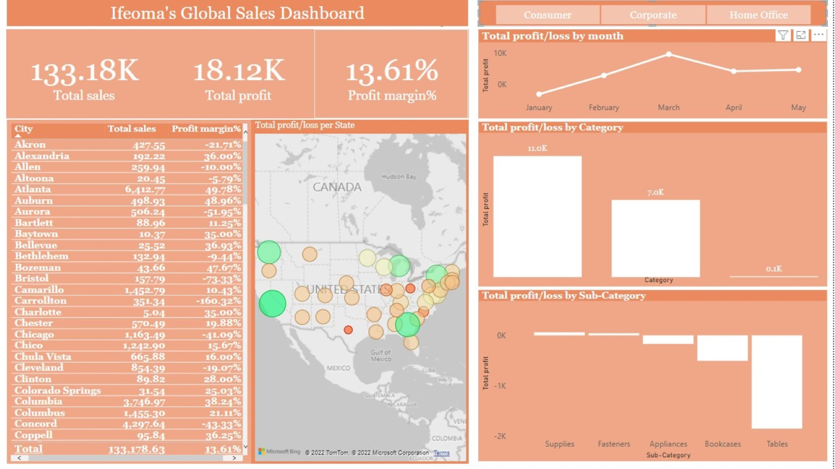

Slide 4
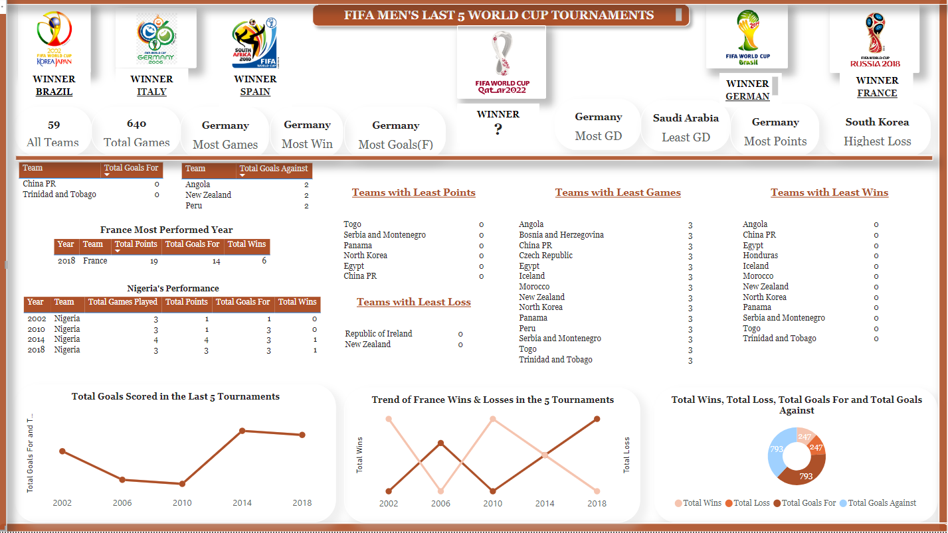

Slide 5
WORKING WITH MICROSOFT EXCEL

Slide 6
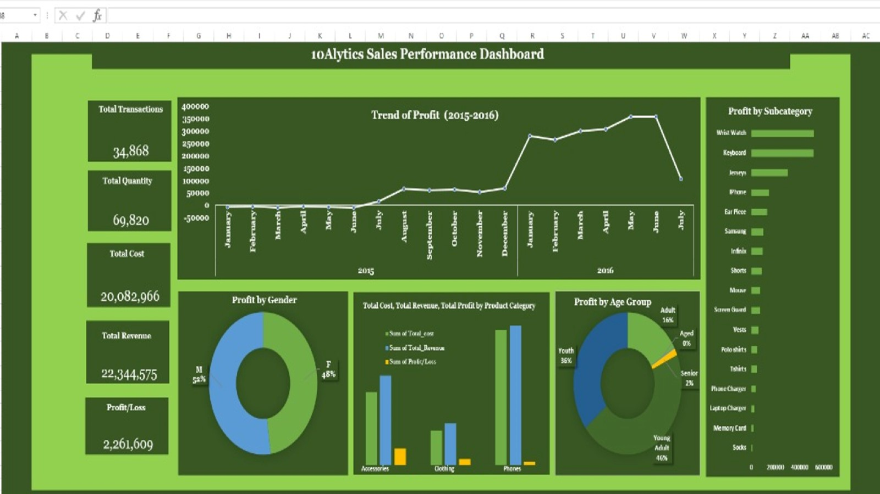

Slide 7
